Slide 1
Generative Adversarial Nets

Slide 2
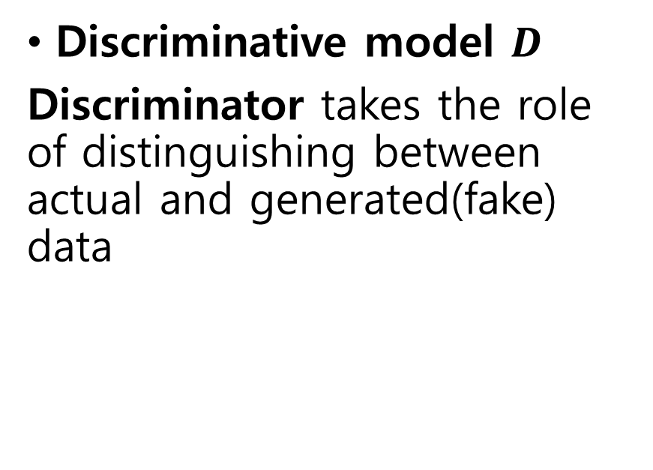
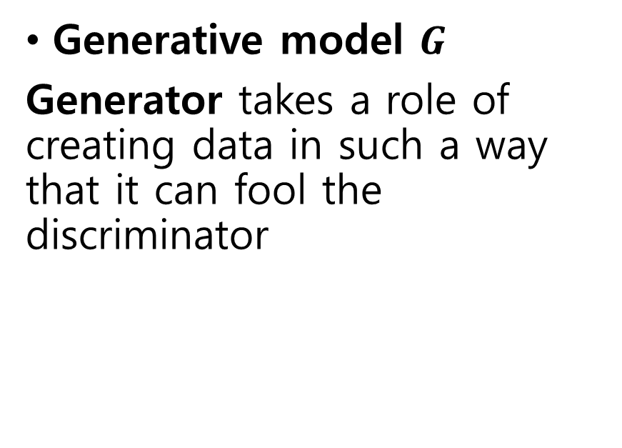
Two models
Generative model $G$
Generator takes a role of creating data in such a way that it can fool the discriminator
Discriminative model $D$
Discriminator takes the role of distinguishing between actual and generated(fake) data

Slide 3
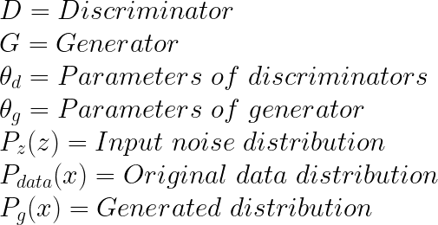
Parameters and Variables

Slide 4
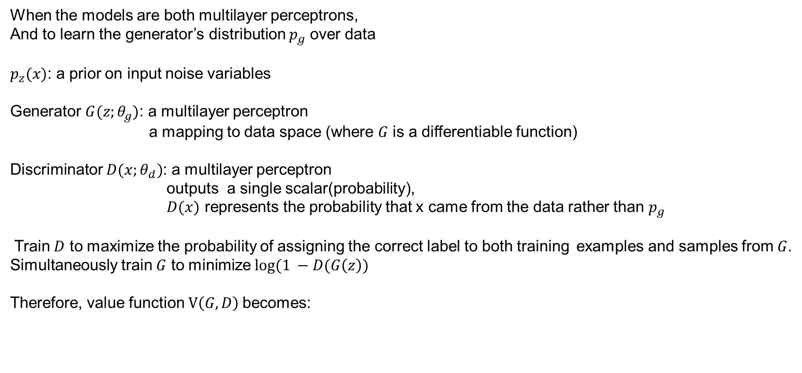
3. Adversarial nets
When the models are both multilayer perceptrons,
And to learn the generator’s distribution $p_{g}$ over data
$p_{z}(x)$: a prior on input noise variables
Generator $G(z;θ_{g})$: a multilayer perceptron
a mapping to data space (where $G$ is a differentiable function)
Discriminator $D(x;θ_{d})$: a multilayer perceptron
outputs a single scalar(probability),
$D(x)$ represents the probability that x came from the data rather than $p_{g}$
Train $D$ to maximize the probability of assigning the correct label to both training examples and samples from $G$.
Simultaneously train $G$ to minimize $log⁡(1 −D(G\left(z\right))$
Therefore, value function $V\left(G, D\right)$becomes:
Notes:
Generator's distribution pg over data x를 학습하기 위해 generator의 input으로 들어갈 noise variables pz(z)에 대한 prior를 정의하고, data space로의 mapping을 G(z;θg)라 표현할 수 있습니다. 여기서 G는 미분 가능한 함수로써 θg를 parameter로 갖는 multilayer perceptron입니다. 한편, Discriminator 역시 multilayer perceptron으로 D(x;θd)로 나타내며 output은 single scalar 값이 되겠다(확률이므로). D(x)는 x가 pg가 아닌 data distribution으로부터 왔을 확률을 나타냅니다. 따라서, 이를 수식으로 정리하면 다음과 같은 value function V(G,D)에 대한 minimax problem을 푸는 것과 같아집니다;
minGmaxDV(D,G)=Ex∼pdata (x)[logD(x)]+Ez∼px(z)[log(1−D(G(z)))]

Slide 5
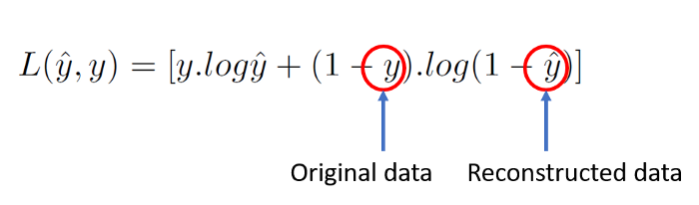


Binary cross-entropy loss formula
Discriminator loss formula
Generator loss formula
Combined loss function

Slide 6
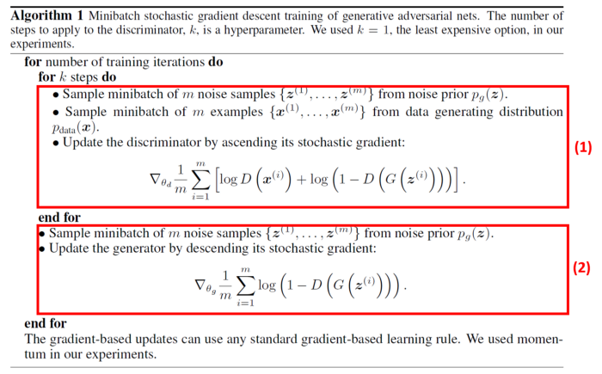
4. Theoretical Results
Algorithm 1
Generator and discriminator are trained separately
In the first section,
Real data and fake data are inserted into the discriminator with correct labels
Gradients are propagated keeping generator fixed.
The discriminator is updated by ascending its stochastic gradient
In the second section,
Fake data with fake labels are passed to fool the discriminator keeping the discriminator fixed
The generator is updated by descending its stochastic gradient
Notes:
It can be noticed from the above algorithm that the generator and discriminator are trained separately.
In the first section, real data and fake data are inserted into the discriminator with correct labels and training takes place. Gradients are propagated keeping generator fixed. Also, we update the discriminator by ascending its stochastic gradient because for discriminator we want to maximize the loss function given in equation (6).
On the other hand, we update the generator by keeping discriminator fixed and passing fake data with fake labels in order to fool the discriminator. Here, we update the generator by descending its stochastic gradient because for the generator we want to minimize the loss function given in equation (6).

Slide 7
References
https://arxiv.org/pdf/1406.2661.pdf
https://towardsdatascience.com/the-math-behind-gans-generative-adversarial-networks-3828f3469d9c
https://jaejunyoo.blogspot.com/2017/01/generative-adversarial-nets-1.html

